Slide 1
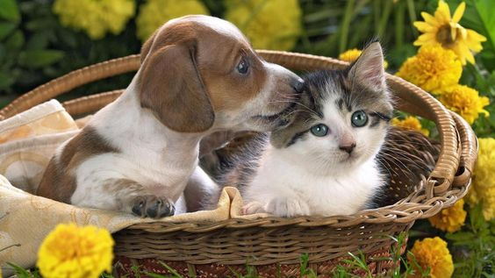

CATS AND DOGS CLASSIFICATION USING TENSORFLOW
By:
Ian Tirok
Beatrice Kiplagat
Kelvin Njung’e
Jon Ruoro

Slide 2
DATASET
This dataset was first introduced to users in a Kaggle competition in 2013, whose goal was to write an algorithm to classify whether images contain either a dog or a cat. Since then, users have used the dataset for image recognition practice.
The dataset contains 12,500 labelled images of dogs & 12,500 labelled images of cats.
The link is available here.

Slide 3
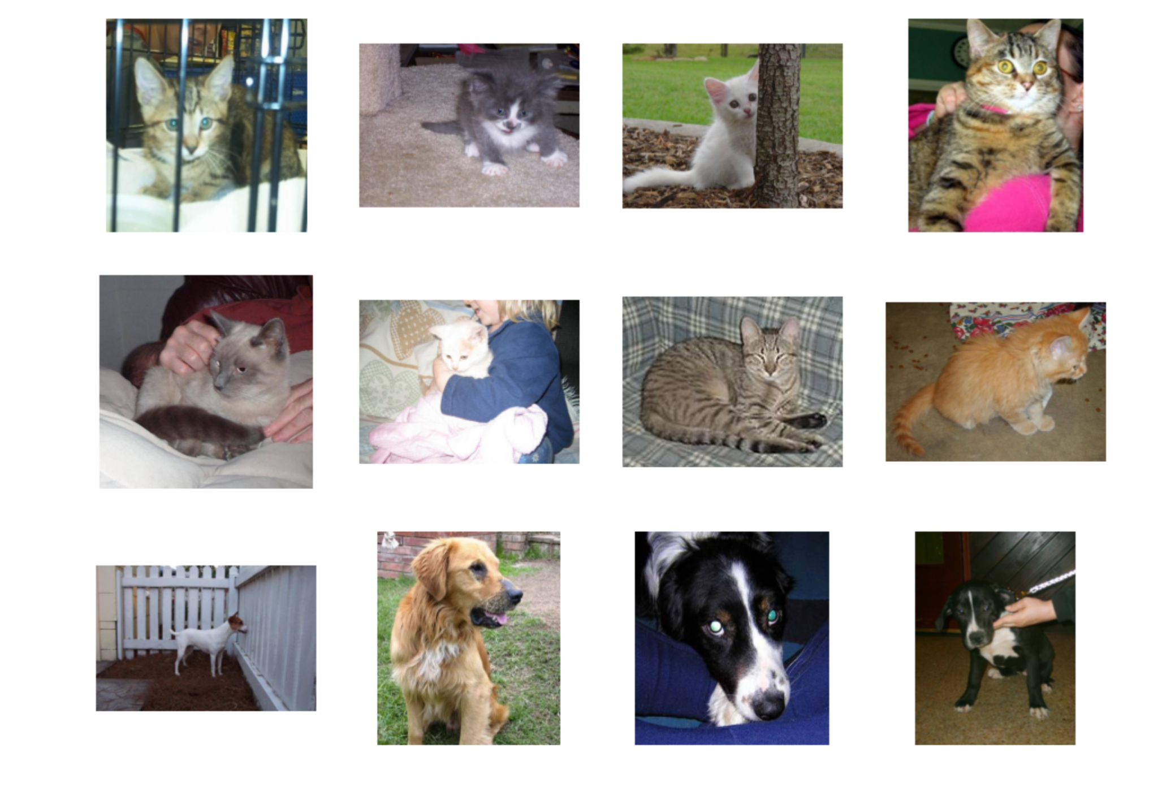
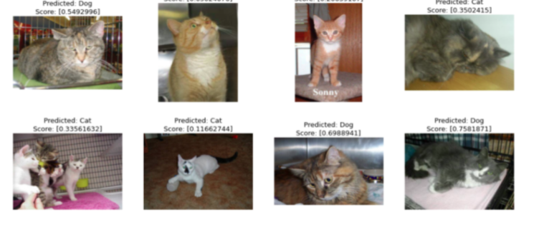
Sample of the pictures in the dataset

Slide 4
Exploring the dataset
From the samples, we can see that:
The dataset contains different breeds of both cats and dogs.
The backgrounds in the images are quite different from each other. In some cases, the animals are being held. The difference in background, and the mismatched labels will affect the accuracy of the model.
The images have different shapes and sizes. Some are portrait while others are landscape or square.
In some cases, some animals have been wrongly labelled, and this may be due to the fact that they bear a resemblance to the animal labelled. This will pose a challenge for our model.
Some images contain more than one animal or the animal is barely visible due to its color/background, thus affecting the accuracy of our model.

Slide 5
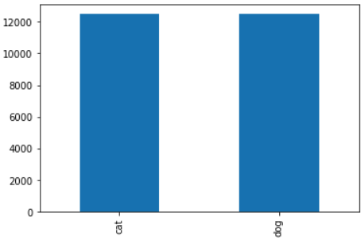
Exploratory Data Analysis.
There was minimal EDA since we are dealing with images.
We were able to plot the total number of each label, to check if the classes are balanced.
We found the classes to be balanced since they have equal proportions.
Created directories to separate the images of cats and dogs.

Slide 6
Splitting the datasets
We split our data into training and validation sets for each label.
We split them into 10,000 images for both cats and dogs for the train set and 2,500 images for the validation sets.

Slide 7
Modelling with Keras
We decided to use sequential modelling since it allows us to easily stack layers and it allows us to build models layer by layer.
We used the add() function to add layers.
We used Convolutional Neural Networks with 64, 128 & 512 output channels and the Rectified Linear Unit(ReLU) activation function.
We also added a batch normalisation layer.
We used the sigmoid function for our output layer.
We compiled our loss using the binary crossentropy since this is a binary classification with a learning rate of (1e-4)

Slide 8
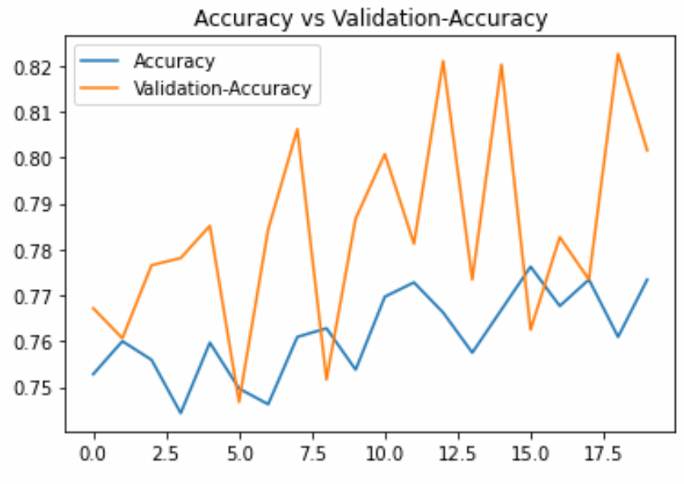
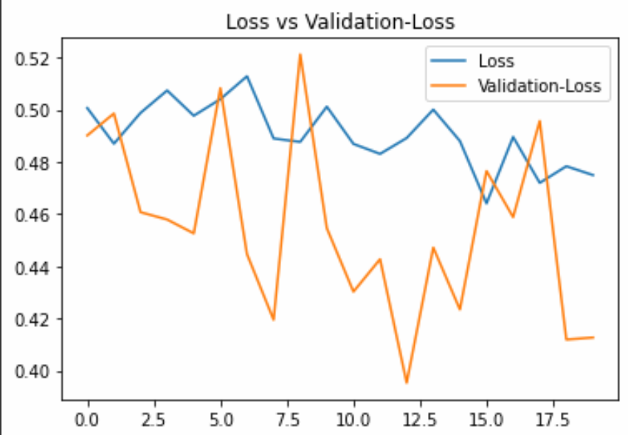
Model Accuracy
The model was 80.16 percent. This was acceptable as the success criteria required a model accuracy of above 80 percent.
The average loss was about 0.5012.

